Slide 1




FUTURE TECHNOLOGY
What is Artificial Intelligence?
page 01
Artificial Intelligence refers to the simulation of human intelligence in machines that are programmed to think like humans and mimic their actions.

Slide 2
The concept of AI dates back to ancient Greece, where myths told of robots and automata. However, modern AI began in the 1950s with the Dartmouth Summer Research Project on Artificial Intelligence.
History of AI
page 02
AI_ML_007 (Aryan)

Slide 3
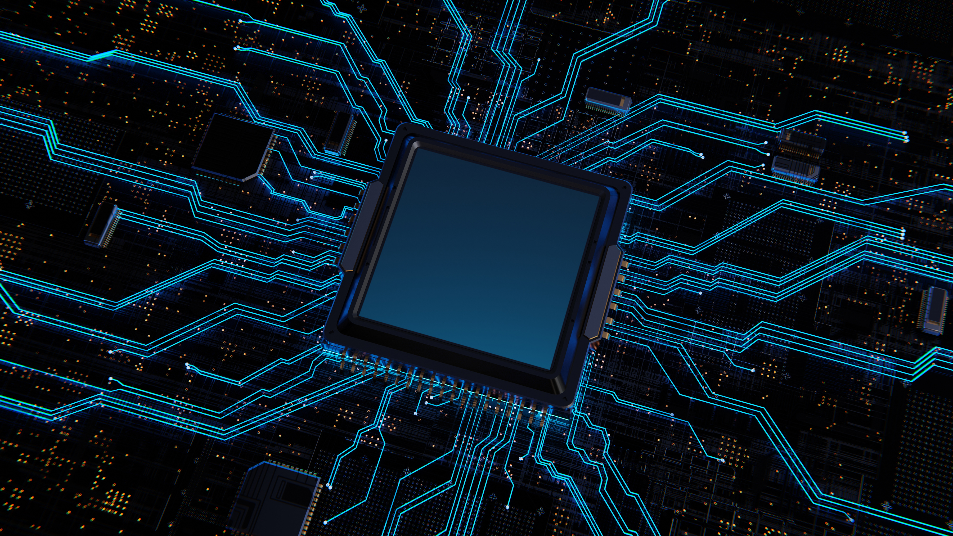
Types of AI
There are several types of AI, each addressing specific challenges: Narrow or Weak AI, General or Strong AI, and Superintelligence.
page 03
AI_ML_007 (Aryan)

Slide 4

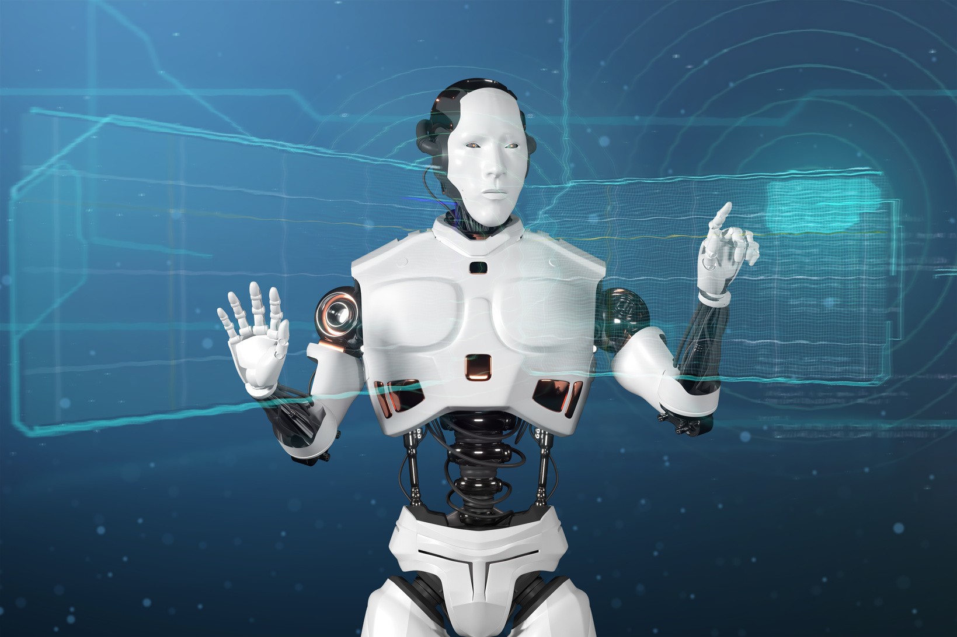
Applications of AI
AI has numerous applications across industries: Computer Vision, Natural Language Processing (NLP), Robotics, and Predictive Maintenance.
page 04
AI_ML_007 (Aryan)

Slide 5
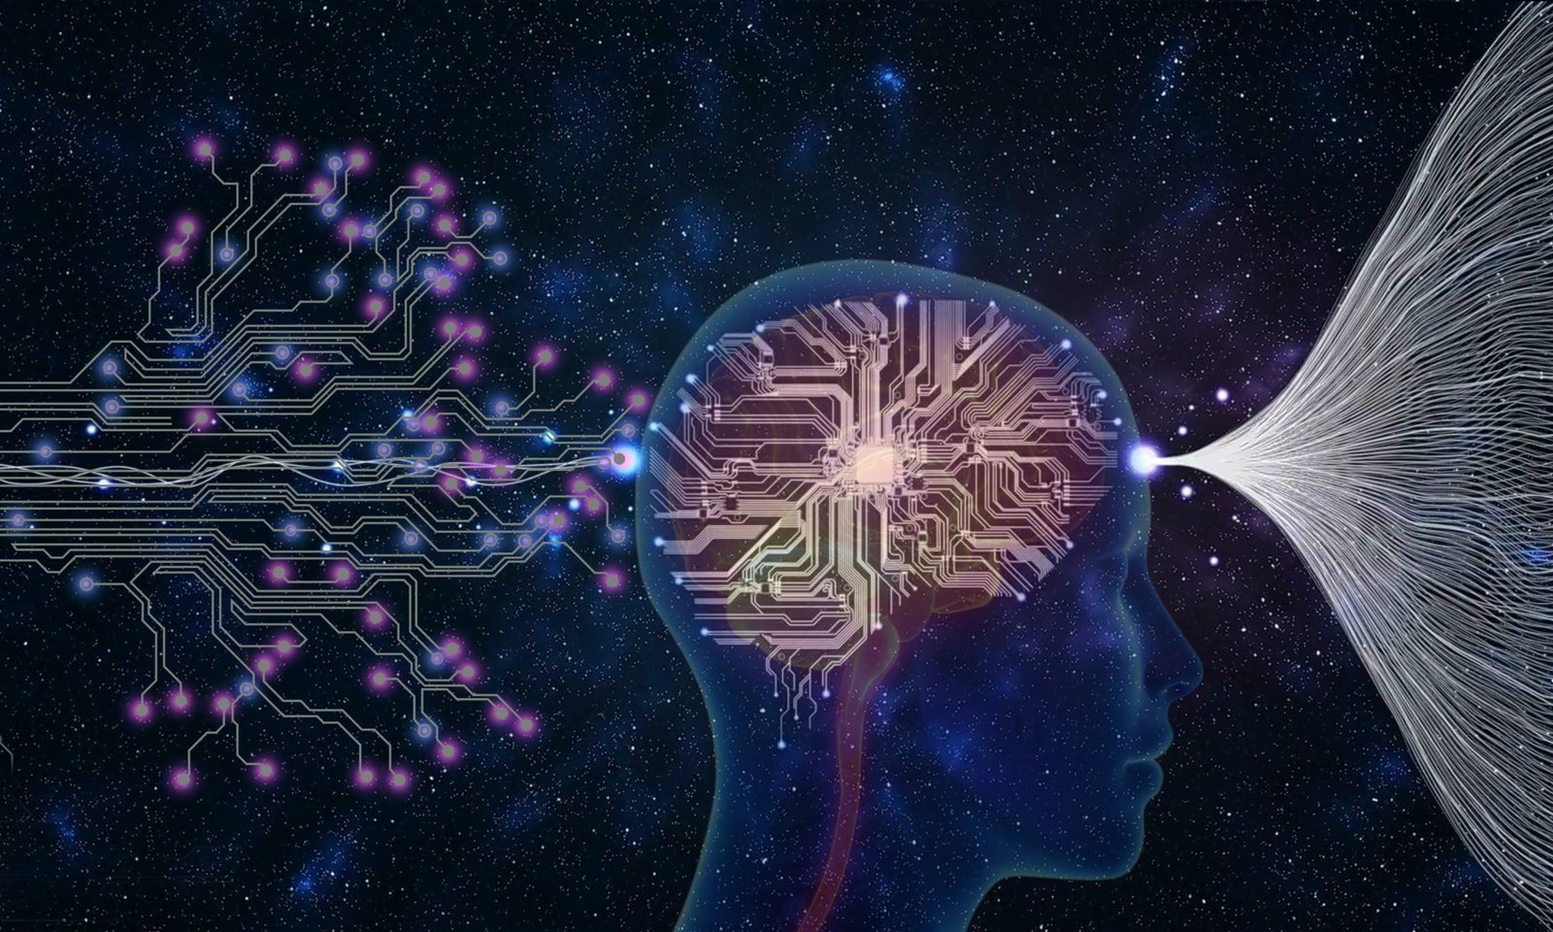
Machine Learning and Deep Learning
Two essential concepts in AI are Machine Learning (ML) and Deep Learning (DL): ML enables machines to learn from data without explicit programming.
page 05
AI_ML_007 (Aryan)

Slide 6
Ethics and Bias
As AI becomes increasingly pervasive, it's essential to address concerns around bias, fairness, and accountability: Bias in Data, Job Displacement, and Data Privacy.
page 06
AI_ML_007 (Aryan)

Slide 7
Conclusion
Artificial Intelligence is a rapidly evolving field that has transformed industries, revolutionized healthcare, and improved our daily lives.
page 07
AI_ML_007 (Aryan)

Slide 8
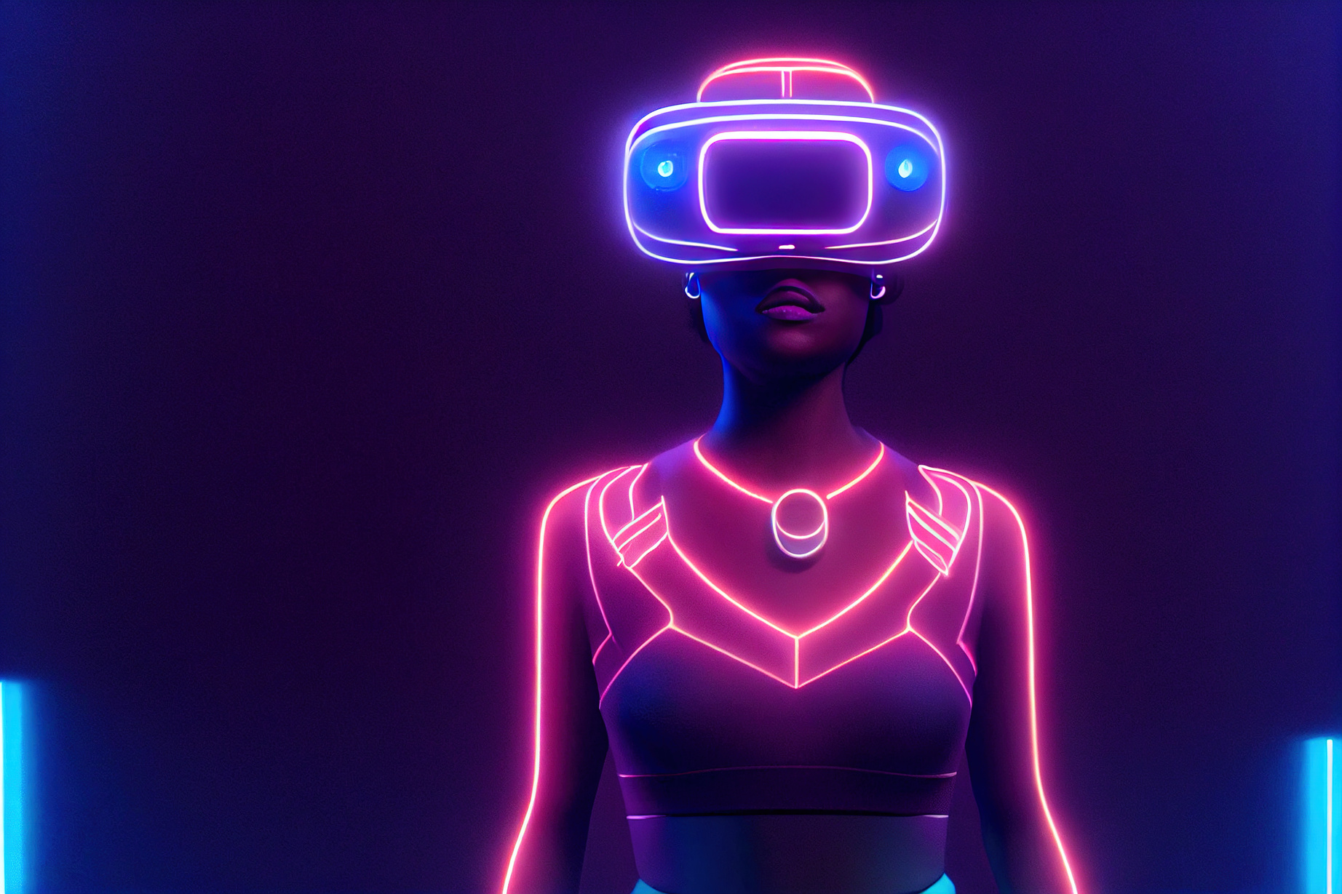
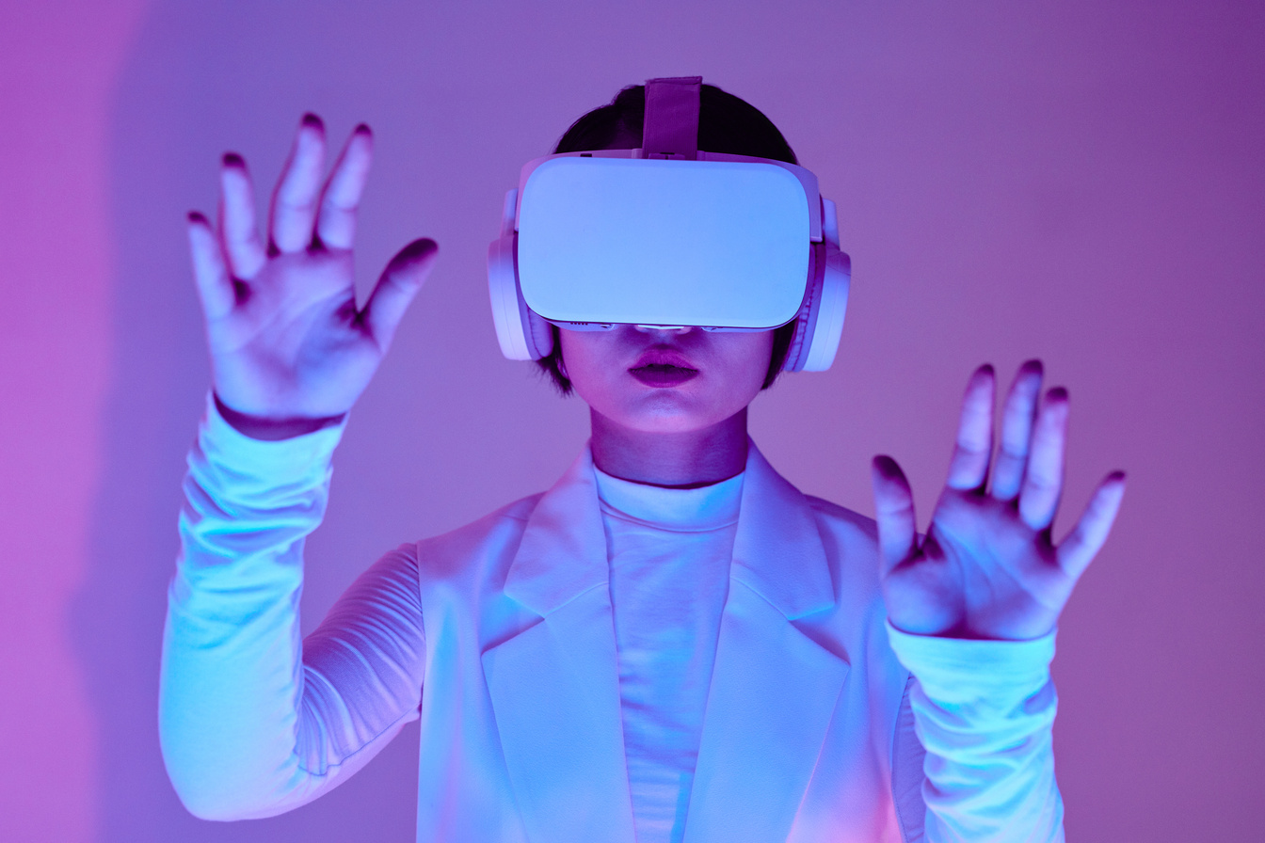
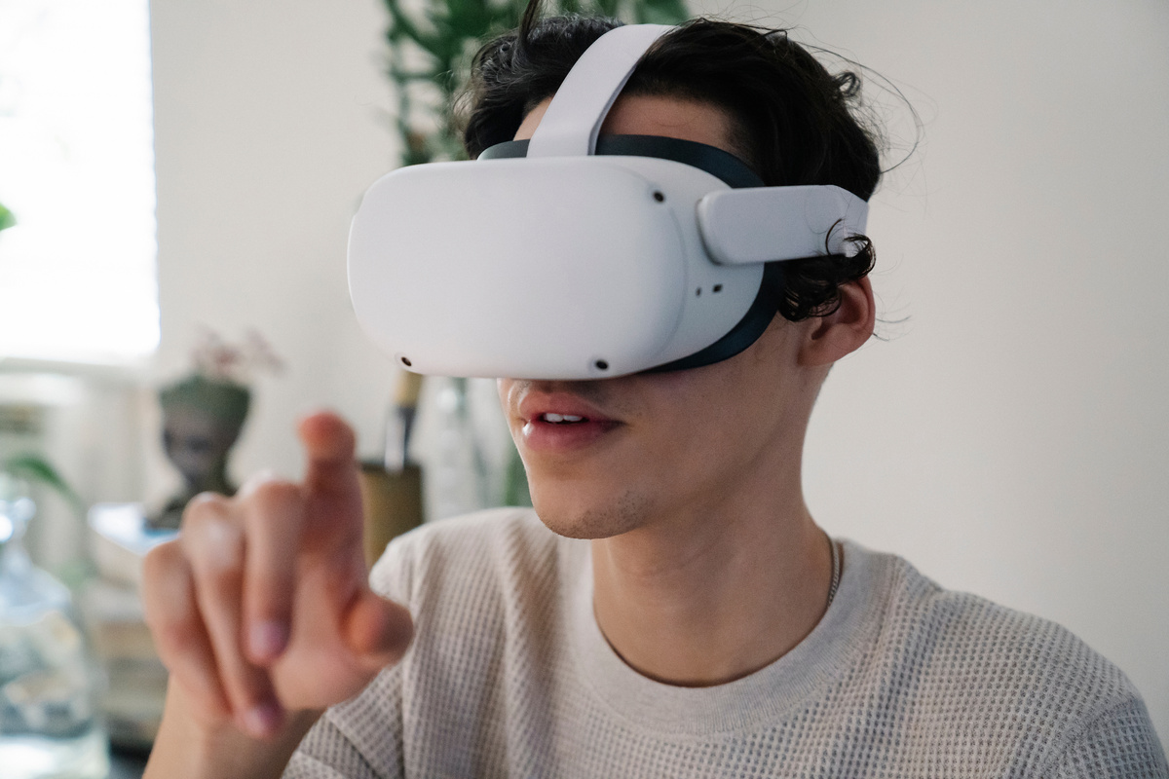
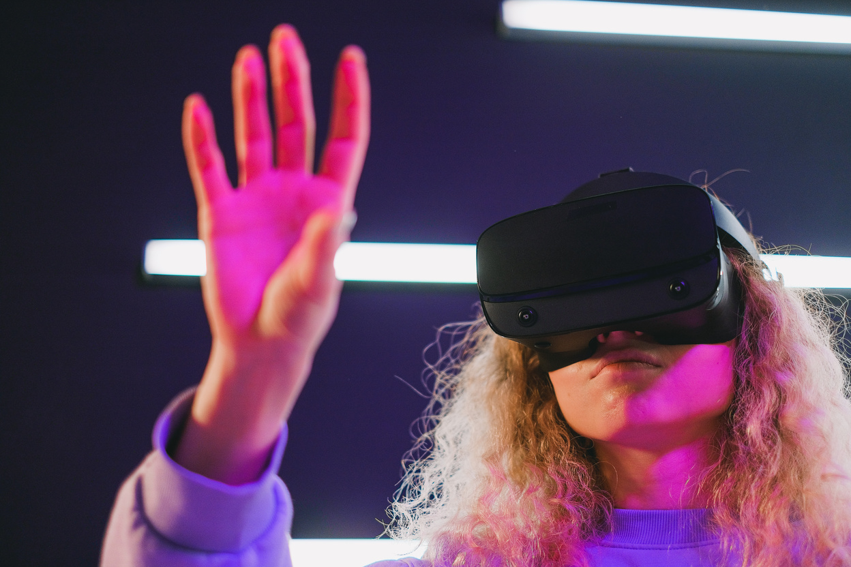
Key Takeaways
There are various types of AI, including narrow, general, and superintelligence.
page 08
AI_ML_007 (Aryan)

Slide 9

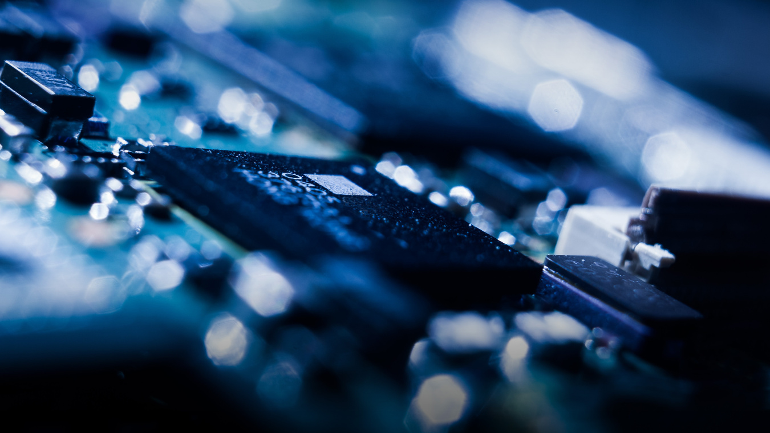
Introduction to Artificial Intelligence
Welcome, students, to our exploration of the fascinating world of Artificial Intelligence (AI).
page 09
AI_ML_007 (Aryan)

Slide 10
THANK YOU!
page 10
AI_ML_007 (Aryan)

